Slide 1
Generative AI for East Asian Studies: Use Cases
Hongsu WANG
Senior Project Manager of the China Biographical Database Project
April 2023

Slide 2
Summarize PDF Articles

Slide 3
Reviews on AI Summarizations (Blind Test)
Professor Peter Bol (Chinese Studies)
Professor Michael Szonyi (Chinese Studies)
Doctor Katherine Matsuura (Japanese Studies)
Professor Jae-Jung Suh (Korean Studies)

Slide 4
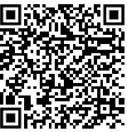
Professor Peter Bol (Chinese Studies) For Perfect Order: Wang An-Shih And Ssu-Ma Kuang
https://github.com/fccsdigitalchina/generative_ai_east_asian_studies/tree/main/Summarization_article_cases/Peter_Bol

Slide 5
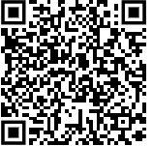
Professor Michael Szonyi (Chinese Studies) Land Markets, Property Rights, And Corporate Organization In Late Imperial China: Preliminary Reflections On Recently Discovered Materials From Fujian
https://github.com/fccsdigitalchina/generative_ai_east_asian_studies/blob/main/Summarization_article_cases/Michael_Szonyi.pdf

Slide 6
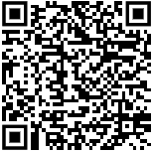
Doctor Katherine Matsuura (Japanese Studies) House Of Mirrors： American History-Writing On Japan by Carol Gluck
https://github.com/fccsdigitalchina/generative_ai_east_asian_studies/blob/main/Summarization_article_cases/Katherine_Matsuura.pdf

Slide 7
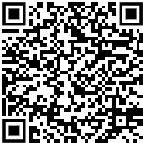
Professor Jae-Jung Suh (Korean Studies) Democratic Consolidation and Its Limits in Korea: Dilemmas of Cooptation
https://github.com/fccsdigitalchina/generative_ai_east_asian_studies/blob/main/Summarization_article_cases/Jae-Jung_Suh.pdf

Slide 8

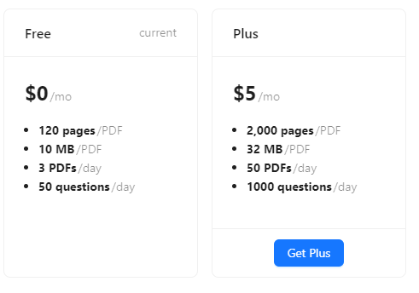
https://www.chatpdf.com

Slide 9
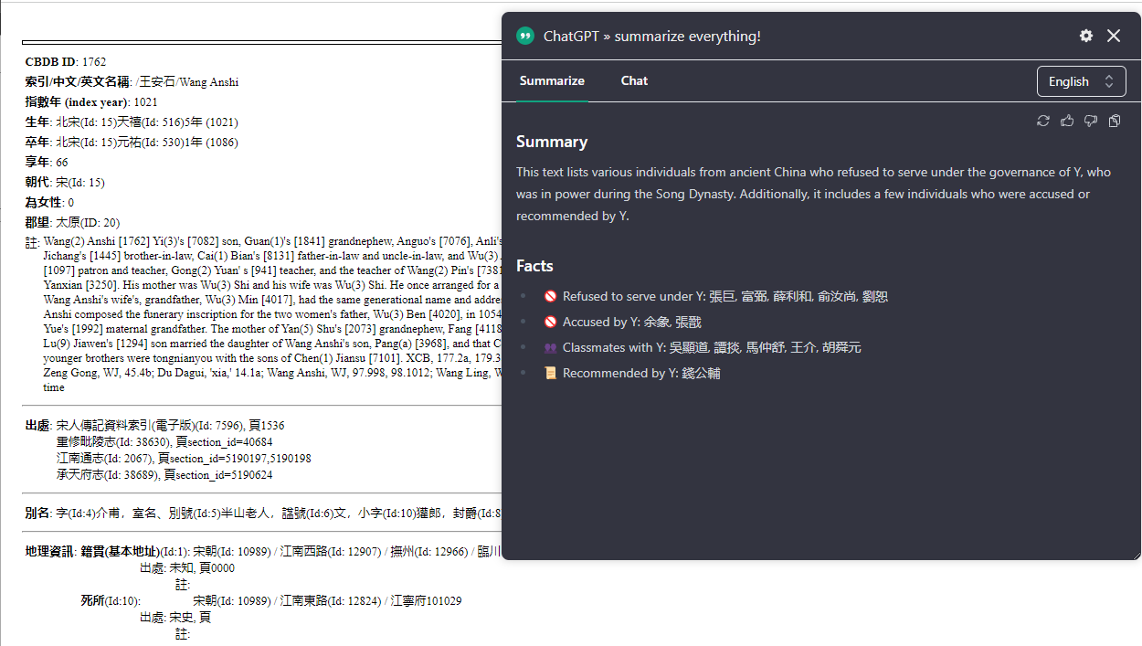
ChatGPT » summarize everything! – Chrome Plugin

Slide 10
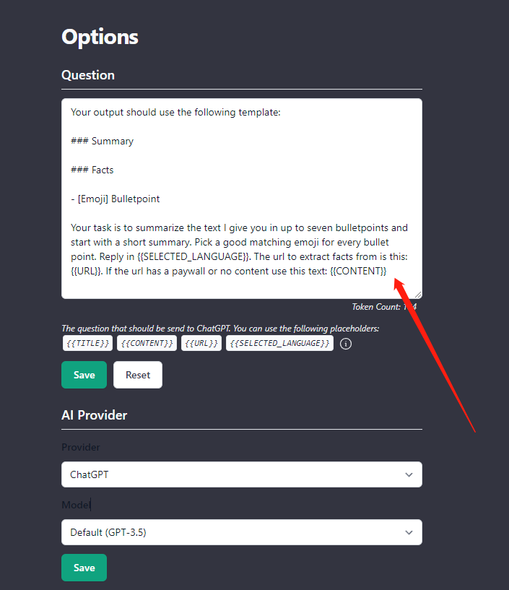

Slide 11
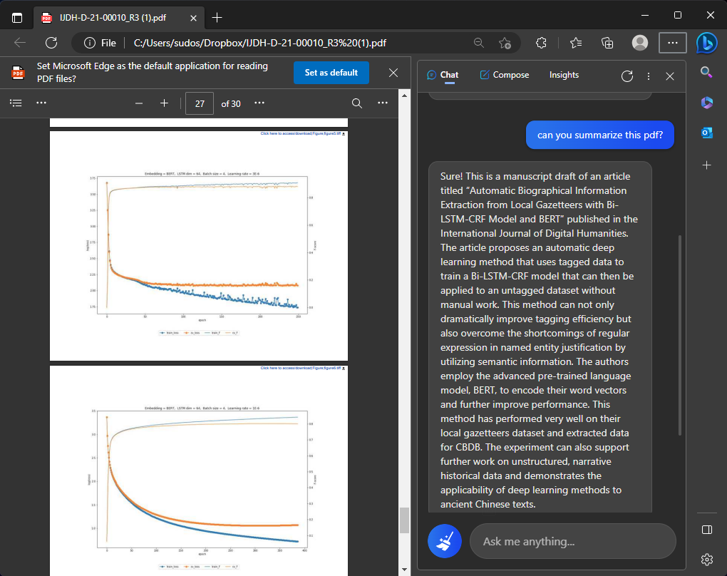
Edge: Web page, PDF

Slide 12
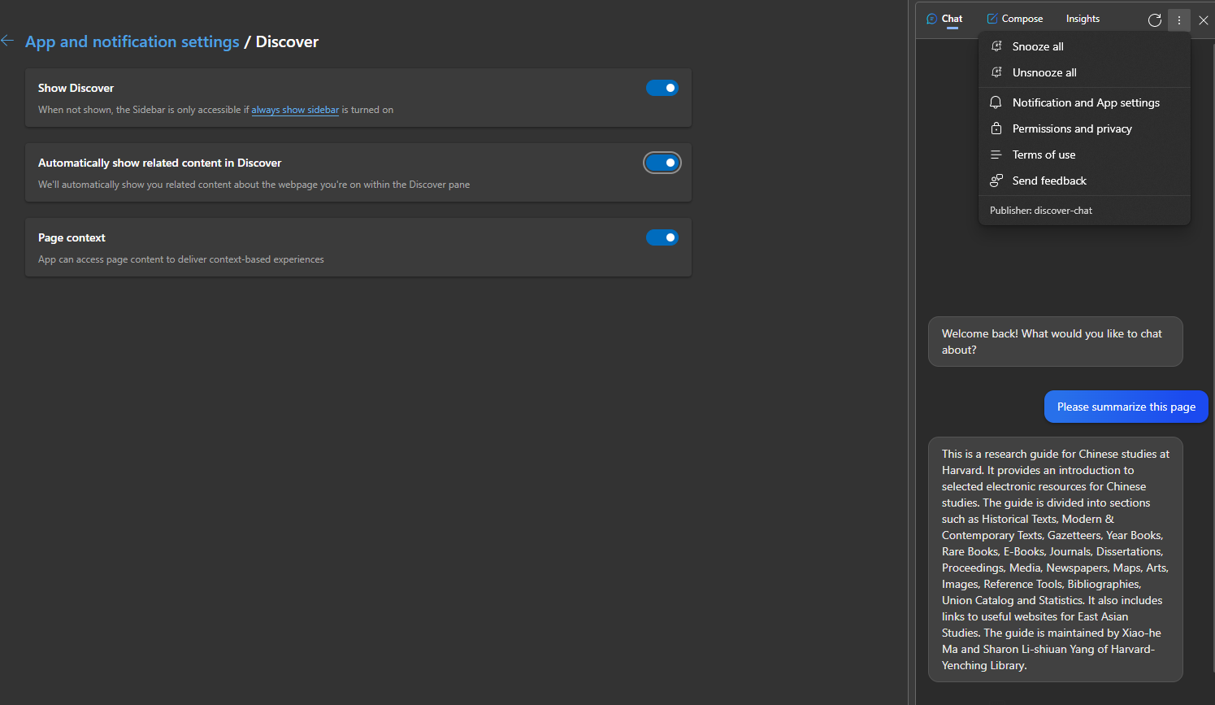


Slide 13
Use Cases
Summarize Articles
Create and Clean Data
Code (Standardize) Data
Data Analysis
Data Visualization

Slide 14
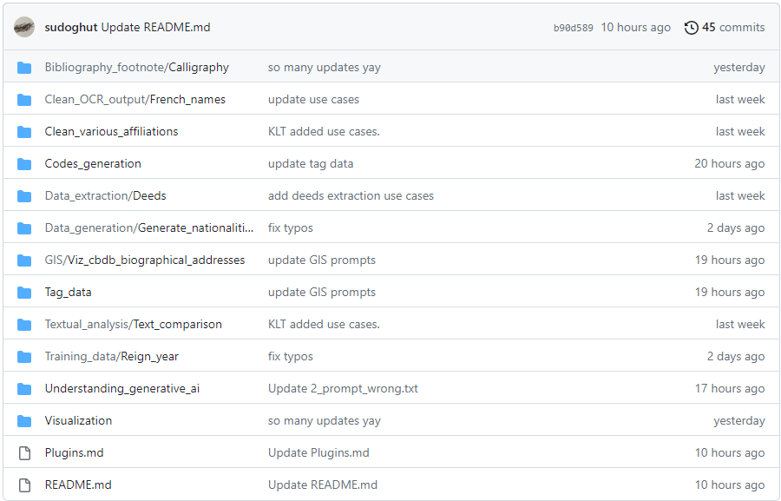
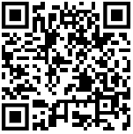

https://github.com/fccsdigitalchina/generative_ai_east_asian_studies

Slide 15
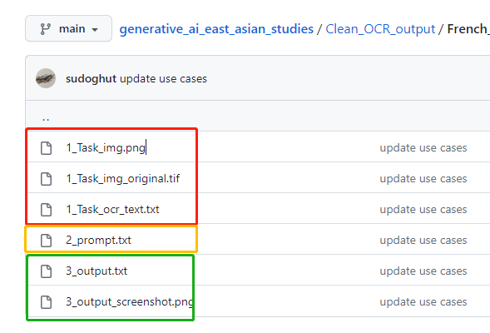

Slide 16
Create and Clean Data

Slide 17
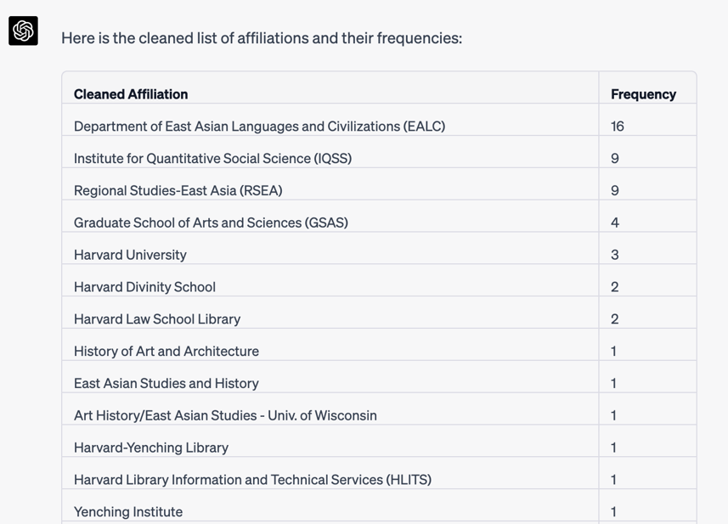
https://github.com/fccsdigitalchina/generative_ai_east_asian_studies/tree/main/Clean_various_affiliations
Clean Various Affiliations

Slide 18
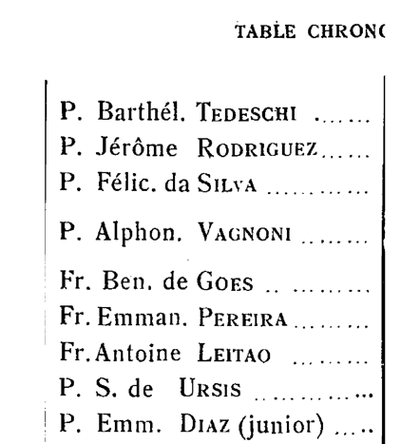
Create data from OCR
Notices Biographiques Et Bibliographiques Sur Les Jésuites de L‘ancienne Mission de Chine, 1552 – 1773
(Biographical And Bibliographical Notes On The Jesuits Of The Mission Of Late Imperial China, 1552 - 1773)
Professor Jianguo LIU
https://github.com/fccsdigitalchina/generative_ai_east_asian_studies/tree/main/Clean_OCR_output/French_names

Slide 19
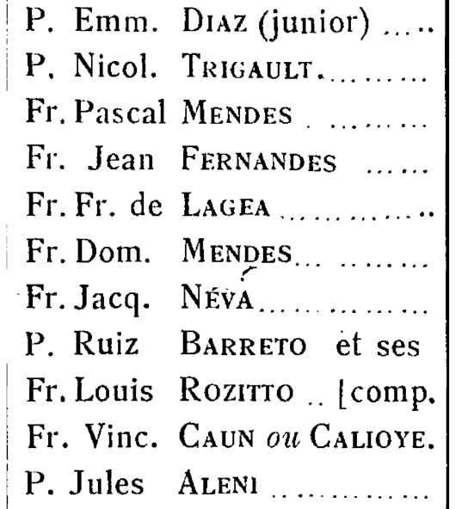
P. Emm. Diaz (junior) ..... P, Nicol. Trigault.
Fr. Pascal Mendes .
Fr. Jean Fernandes
Fr. Fr. de Lagea
Fr. Dom. Mendes
Fr. Jacq. Néva
P. Ruiz Barreto et ses Fr. Louis Rozitto .. [comp. Fr. Vinc. Caun om Calioye. P. Jules Aleni

Slide 20
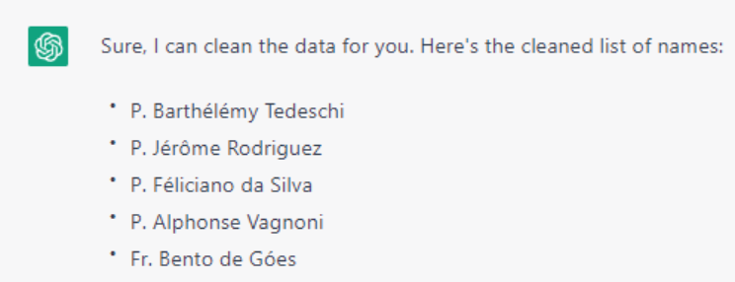
https://github.com/fccsdigitalchina/generative_ai_east_asian_studies/blob/main/Clean_OCR_output/French_names/2_prompt.txt

Slide 21
Prompt: Description
I have a list of missionary names in French. They lived in 16c to 18c. please clean the data for me:
[your list]

Slide 22
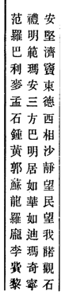
Rearrange Data by Rules
安堅濟竇東德西相沙靜望民望我睹觀不
禮明範瑪安三方巴明居如華如迪瑪奇寧
范羅巴利麥孟石鍾黃郭蘇龍羅龐李費黎
From ABBYY
https://github.com/fccsdigitalchina/generative_ai_east_asian_studies/tree/main/Codes_generation/JavaScript/String_rearrangement

Slide 23
Solution: Generate some JS codes
JavaScript codes
=> Any Browser

Slide 24
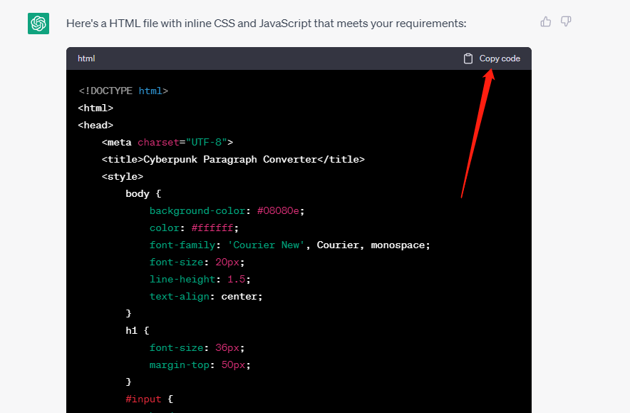
https://github.com/fccsdigitalchina/generative_ai_east_asian_studies/blob/main/Codes_generation/JavaScript/String_rearrangement/2_prompt_3.5.txt

Slide 25
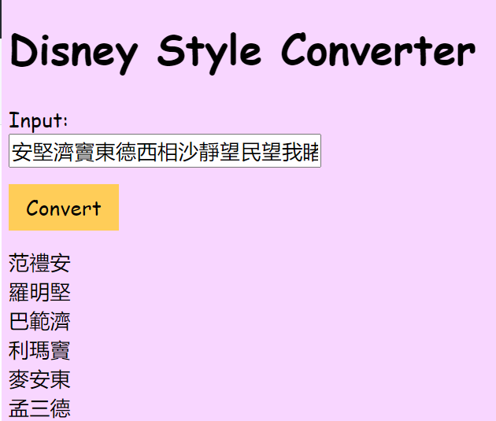
https://github.com/fccsdigitalchina/generative_ai_east_asian_studies/blob/main/Codes_generation/JavaScript/String_rearrangement/1_task.txt

Slide 26
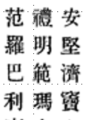
Prompt 3.5: Describe the Algorithm
I have a paragraph. The length of this paragraph(p) can be divided by 3:
a1a2a3...anb1b2b3...bnc1c2c3... cn
I want to create a new 3 characters list(d) by using the corresponding vertical position of each paragraph. The order of picking characters will be from c1b1a1 to cnbnan.(the position of c1 is (length of p)/3*2, b1 is (length of p)/3, a1 is 0. Your loop length should be (length of p)/3). Your for loop step should be 1 instead of 3. The output should be(from left to right):
c1b1a1
c2b2a2
c3b3a3
...
cnbnan
安堅濟竇東德西相沙靜望民望我睹觀不
禮明範瑪安三方巴明居如華如迪瑪奇寧
范羅巴利麥孟石鍾黃郭蘇龍羅龐李費黎

Slide 27
Prompt 3.5: Describe your output schema
Each combination of d should be divided by a line breaker. Please provide a HTML file with inline CSS and JavaScript for a webpage that meets the following suggestions:

Slide 28
Prompt 3.5: Design the Output Layout
1. There is an input box on the page. Users will put a string like this in the input box "安堅濟竇東德西相沙靜望民望我睹觀不禮明範瑪安三方巴明居如華如迪瑪奇寧范羅巴利麥孟石鍾黃郭蘇龍羅龐李費黎". I'm also not sure how many characters each paragraph will have, but the length of the whole text is divisible by three

Slide 29
Prompt 3.5: Design the Output Layout
2. There is a button under the input box. It will trigger your js to convert the input to the output
3. Wrap the output to a <div> under the button
Notes: <div> tag in html stands for division

Slide 30
Prompt 3.5: Prettify Your Layout
4. This webpage should have a Disney style

Slide 31
Open your text editor(Ex. TextEdit on Mac, Notepad on Windows, VS Code, EmEditor, Notepad++…)
Paste the codes that you generated to your text editor
Save it as “xxxx.html”
Double click your web page(html)

Slide 32
Prompt 4.0: Describe Your Patterns Briefly
I have a paragraph. The length of this paragraph(p) can be divided by 3:
安堅濟竇東德西相沙靜望民望我睹觀不禮明範瑪安三方巴明居如華如迪瑪奇寧范羅巴利麥孟石鍾黃郭蘇龍羅龐李費黎
I want to create a new 3 characters list(d) by using the corresponding vertical position of each paragraph. The output should be:
范禮安
羅明堅
巴範濟
利瑪竇
...
黎寧不
https://github.com/fccsdigitalchina/generative_ai_east_asian_studies/blob/main/Codes_generation/JavaScript/String_rearrangement/2_prompt_4.0.txt

Slide 33
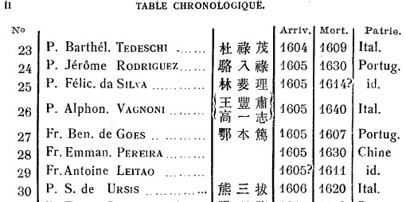
Create data from generative AI
https://github.com/fccsdigitalchina/generative_ai_east_asian_studies/tree/main/Data_generation/Generate_nationalities

Slide 34
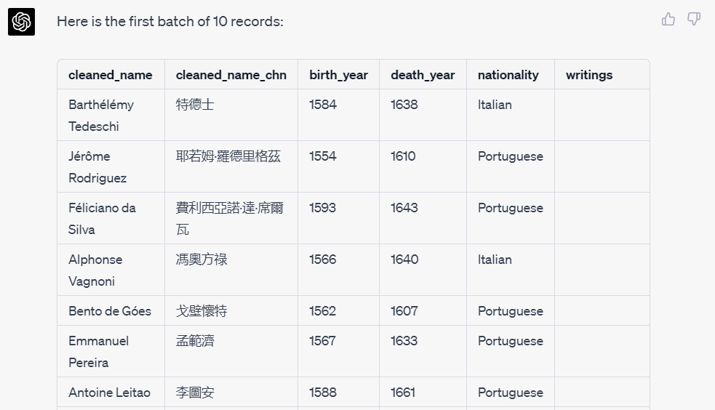
https://github.com/fccsdigitalchina/generative_ai_east_asian_studies/blob/main/Data_generation/Generate_nationalities/2_prompt.txt

Slide 35
Prompt: Description
I have a list of missionary names in French. They lived in 16c to 18c. please clean the data for me, and give them their birth year, death year, their Chinese names, nationalities and writings(multiple writings should be separated by ;)
Most the information can be found in this book: Pfister, L. . A. du texte. (1932). Notices biographiques et bibliographiques sur les Jésuites de l'ancienne Mission de Chine : 1552-1773. Tome II, XVIIIe siècle / par le P. Louis Pfister,... Chang-Hai.

Slide 36
Prompt: Output Schema and Define Batch Number
Generate 10 records per batch in this format:
|cleaned_name|cleaned_name_chn|birth_year|death_year|nationality|writings|
| -- | -- | -- | -- | -- | -- |
Notes:
Markdown format

Slide 37
Prompt: Next Batch Trigger
Pause after generating each batch and wait for my input "continue" to generate the next batch.

Slide 38
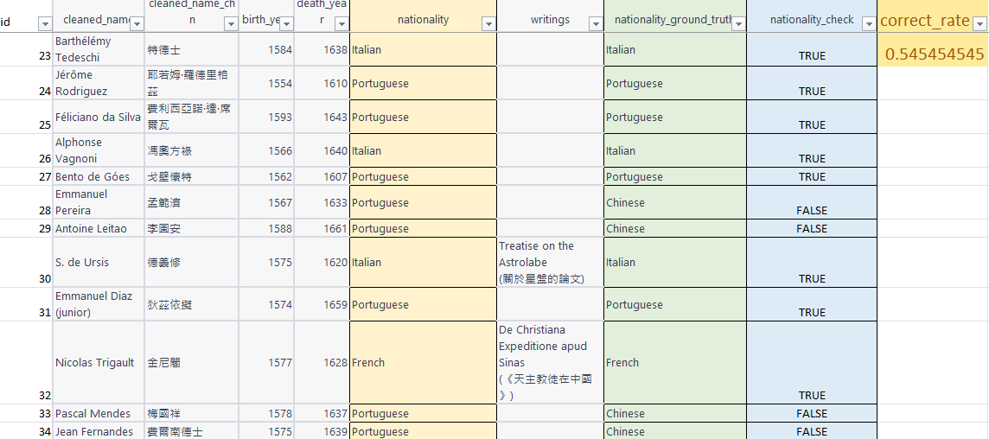
Correct Rate of Nationality (ChatGPT 4.0)
https://github.com/fccsdigitalchina/generative_ai_east_asian_studies/blob/main/Information_generate/Generate_nationalities/3_output_check.xlsx

Slide 39
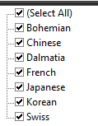
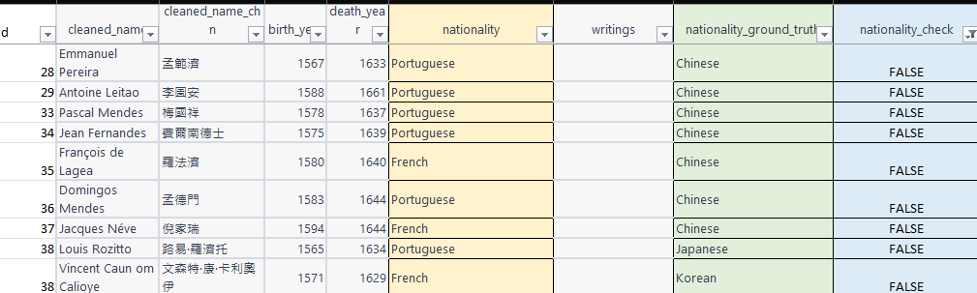
Observe the Data: False

Slide 40
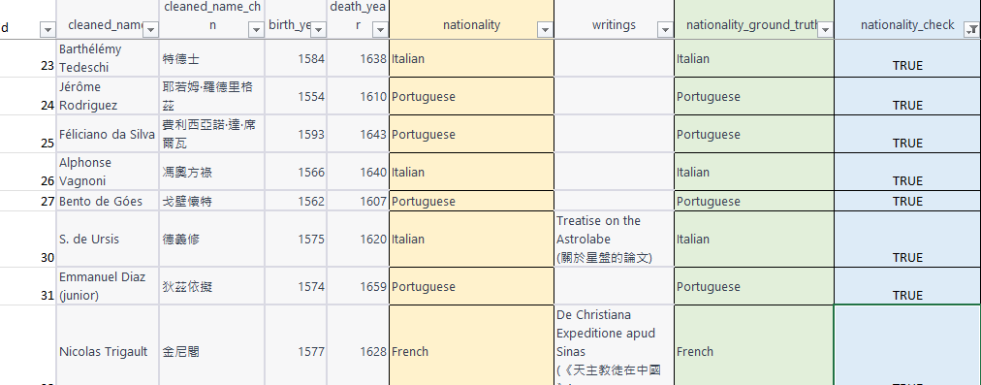
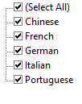
Observe the Data: True

Slide 41
The correct rate for nationality equals to Western and Southern Europe
94.9 %
P(T|E) = P(E|T)*P(T)/(P(E|T)P(T)+P(E|F)P(F))
=0.94*0.54/(0.94*0.54+0.06*0.45)
=0.949

Slide 42
Code (Standardize) Data

Slide 43
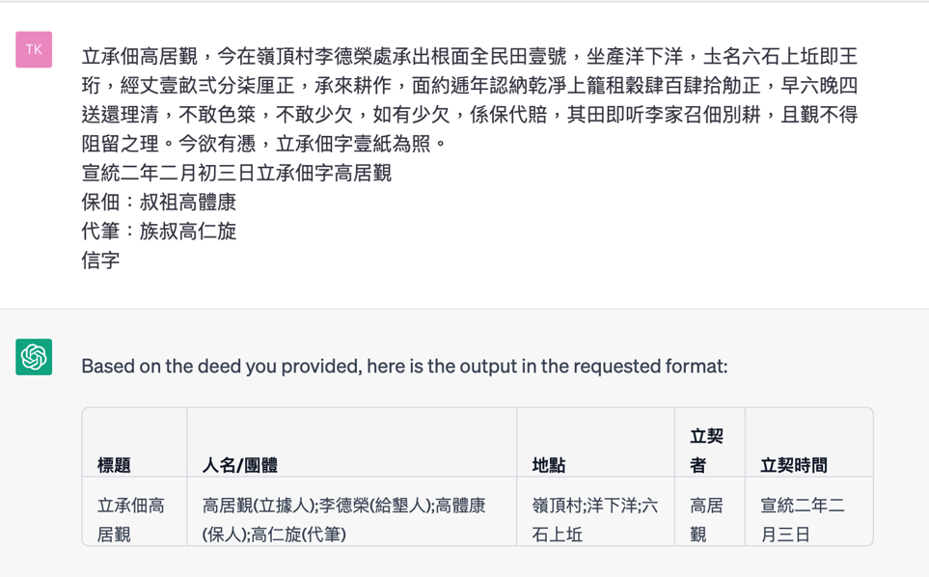
https://github.com/fccsdigitalchina/generative_ai_east_asian_studies/tree/main/Data_extraction/Deeds
Data Extraction

Slide 44
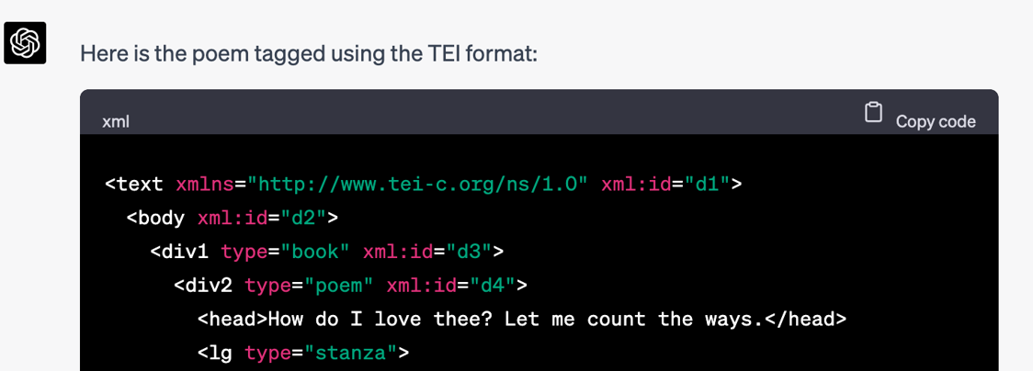
https://github.com/fccsdigitalchina/generative_ai_east_asian_studies/tree/main/Tag_data/Tag_TEI
Tag TEI

Slide 45
Tag Social Associations (For 4.0)
【徐几】，字字与，号进斋，崇安人。博通经史，尤精于易。景定间与【何基】同以布衣召补迪功郎，添差建宁府教授，兼建安书院山长，撰经义以训式多士。
【林灵素】，字通叟，永嘉人。七岁能诗，日记累万言。【苏轼】一见惊曰：「子颖异非常，青紫可立待。」灵素笑曰：「生封侯，死立庙，非予志也。」去为道士，善妖幻，以方术得幸徽宗，赐号玄妙先生，惑众僭妄，众皆怨之。在京四年，恣横不悛，斥还故里死。
https://github.com/fccsdigitalchina/generative_ai_east_asian_studies/tree/main/Tag_data/Tag_social_assocations
PKU DH Center, BERT

Slide 46
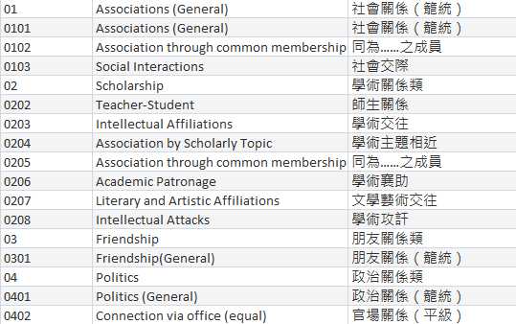
CBDB Association Model (45 types)

Slide 47
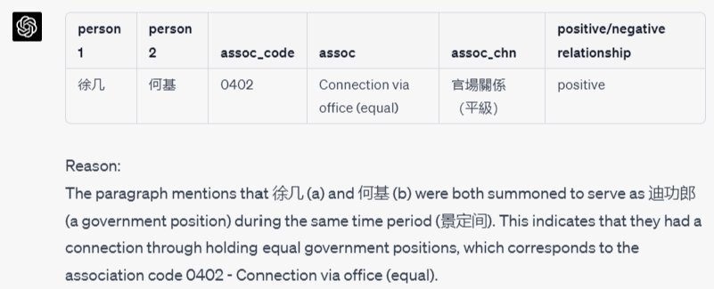
https://github.com/fccsdigitalchina/generative_ai_east_asian_studies/blob/main/Tag_data/Tag_social_assocations/2_prompt.txt

Slide 48
Prompt: Describe Data Model with Details
I have the following social association types:
c_assoc_type_id c_assoc_type_desc c_assoc_type_desc_chn
01 Associations (General) 社會關係（籠統）
0101 Associations (General) 社會關係（籠統）
Association through common membership 同為……之成員
…

Slide 49
Prompt: Design Output Requirement
After you read a paragraph(para), please tell me the social association code for them. Don't use any knowledge outside of the para. The information that you need to capture to identify the social association but will be very close to the persons' name.

Slide 50
Prompt: Design Output Schema
The paragraph is classical Chinese. The output schema should be a table like this:
|person 1|person 2|assoc_code|assoc|assoc_chn|positive/negative relationship|
| -- | -- | -- | -- | -- | -- |
|a|b|c_assoc_type_id|c_assoc_type_desc|c_assoc_type_desc_chn|positive/negative|
Reason:
[You will put your reason for choosing this association type here]

Slide 51
Prompt: Create an Interface (Input Format)
Now:
a is 徐几
b is 何基
para is:
【徐几】，字字与，号进斋，崇安人。博通经史，尤精于易。景定间与【何基】同以布衣召补迪功郎，添差建宁府教授，兼建安书院山长，撰经义以训式多士。

Slide 52
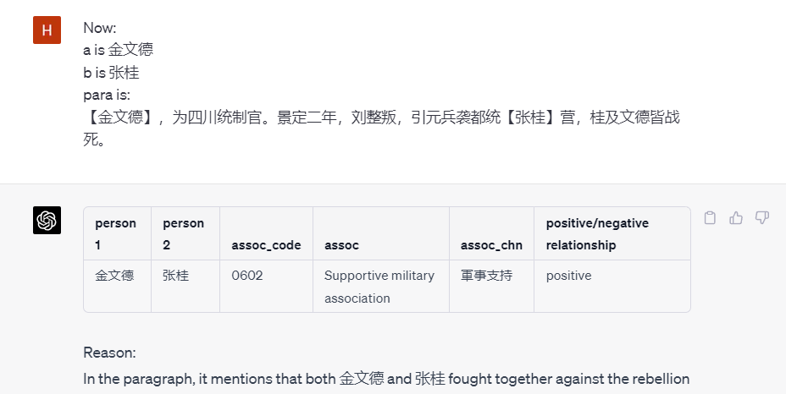
Prompt: Use the Interface
https://github.com/fccsdigitalchina/generative_ai_east_asian_studies/blob/main/Tag_data/Tag_social_assocations/2_prompt_interface.txt

Slide 53
Code (Standardize) Data by Training data

Slide 54
Convert Reign Year to Western Year
慶曆二年
應順元年
崇寧四年
景祐二年
建中靖國元年
顯德元年
同光四年
….
https://github.com/fccsdigitalchina/generative_ai_east_asian_studies/tree/main/Training_data/Reign_year

Slide 55
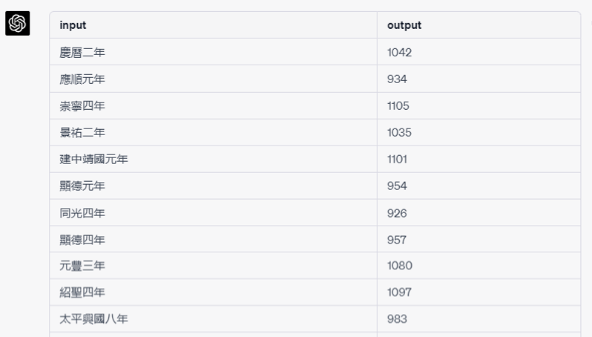
https://github.com/fccsdigitalchina/generative_ai_east_asian_studies/blob/main/Training_data/Reign_year/2_prompt_4.0.txt

Slide 56
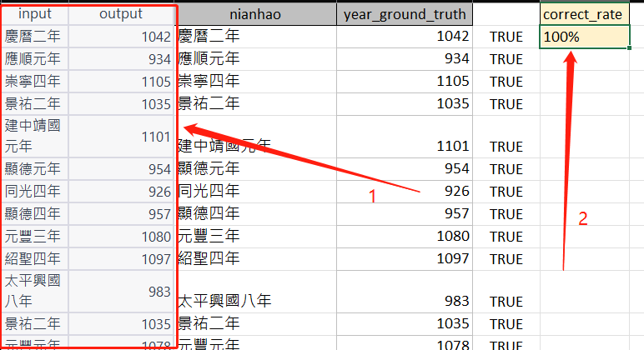
Check the results
https://github.com/fccsdigitalchina/generative_ai_east_asian_studies/blob/main/Training_data/Reign_year/3_output_reign_year_test.xlsx

Slide 57
Prompt 4.0: Describe Your Request
Output the western year from this Chinese reign year information. Don't use any knowledge beyond the information in the table below. There are no typos in the questions.
[Reign year list]

Slide 58
Prompt: Submit Your Training Data
This is the table for your conversion
c_dynasty_chn c_nianhao_chn c_firstyear c_lastyear
隋 大業 605 617
隋 義寧 617 618
唐 武德 618 626
鄭（王世充） 開明 619 621
…

Slide 59
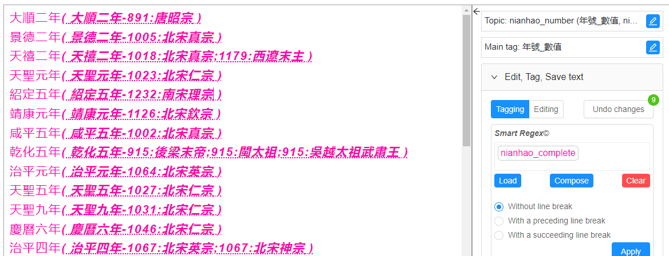
Harvard LoGaRT
https://logart.fairbank.fas.harvard.edu/LGServices/

Slide 60
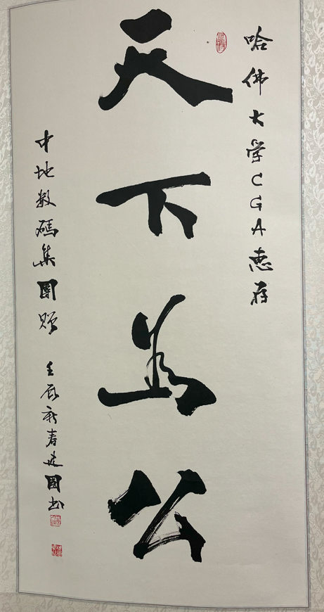
Create bibliography

Slide 61
Create bibliography
I saw a piece of calligraphy in the CBDB office (1737 Cambridge Street, K304, MA, 02138, USA). The author is Jianguo, but I don't know Jianguo's full name. The time information that Jianguo left for this work is the New Year of 壬辰. The content of the calligraphy is: 哈佛大學CGA惠存。天下為公。中地數碼集團贈。壬辰新春建國書. The seals are: 眾緣, 中原人民, 建國印信. I want to cite it in my dissertation. Based on the Chicago Manual of Style, how can I cite it?
https://github.com/fccsdigitalchina/generative_ai_east_asian_studies/tree/main/Bibliography_footnote/Calligraphy

Slide 62
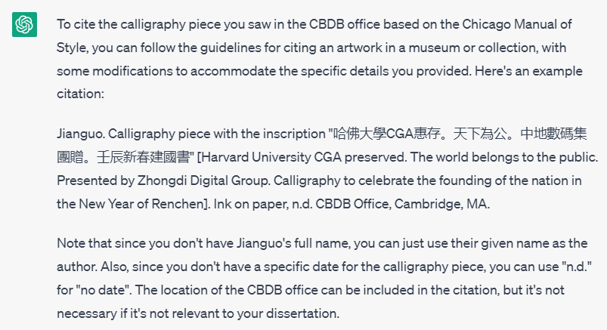
https://github.com/fccsdigitalchina/generative_ai_east_asian_studies/blob/main/Bibliography_footnote/Calligraphy/2_prompt.txt

Slide 63
Data Analysis

Slide 64
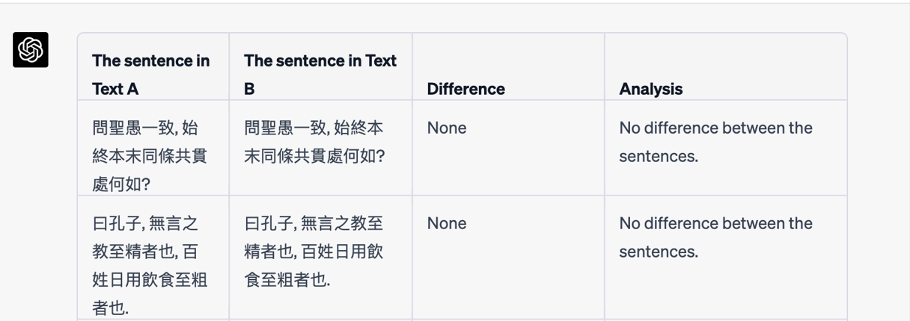
https://github.com/fccsdigitalchina/generative_ai_east_asian_studies/tree/main/Textual_analysis/Text_comparison
Text Comparison

Slide 65
Finding the biographical Addresses for some historical figures and put them on a map

Slide 66
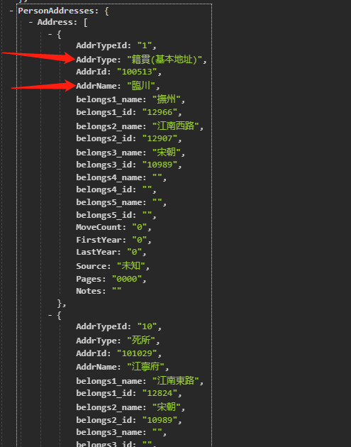
Call API and Parse JSON
https://cbdb.fas.harvard.edu/cbdbapi/person.php?name=%E7%8E%8B%E5%AE%89%E7%9F%B3&o=json
-Package
-PersonAuthority
-PersonInfo
-Person
-PersonAddresses
-Address

Slide 67
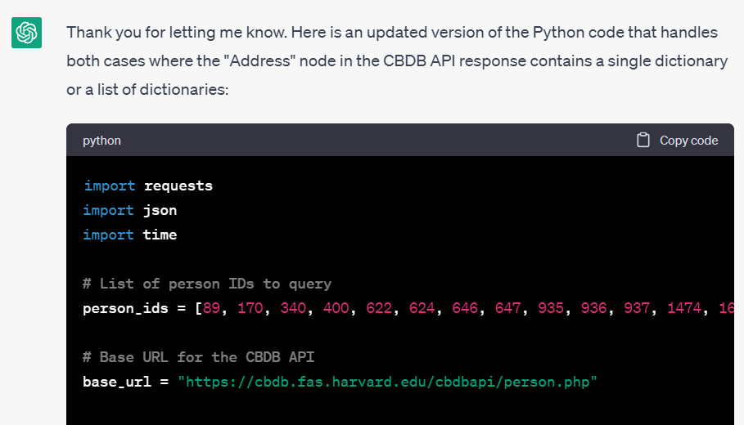
https://github.com/fccsdigitalchina/generative_ai_east_asian_studies/blob/main/GIS/Viz_cbdb_biographical_addresses/2_prompt_1_call_api_find_nodes.txt

Slide 68
Prompt: Describe Your Task Briefly
Here is CBDB API:
https://cbdb.fas.harvard.edu/cbdbapi/person.php?id={personid}&o=json
I have a list of personid
[Person ID List]
please write python codes to query CBDB APIs by these personids separately.
Query interval is 0.5s

Slide 69
Prompt 3.5: Describe API Schema
Please find the Address node(Package-PersonAuthority-PersonInfo-Person-PersonAddresses-Address) that AddrType: "籍貫(基本地址)", get the corresponding AddrName.
The Address node in the CBDB API response might contain a single address element, in which case it is represented as a dictionary, but it might also contain multiple address elements, it is represented as a list of dictionaries.

Slide 70
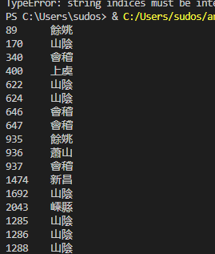
89 餘姚
170 山陰
340 會稽
400 上虞
622 山陰
624 山陰
646 會稽
647 會稽
935 餘姚
936 蕭山
937 會稽
1474 新昌
1692 山陰
2043 嵊縣
1285 山陰
1286 山陰
1288 山陰

Slide 71
Remove ID Column

Slide 72
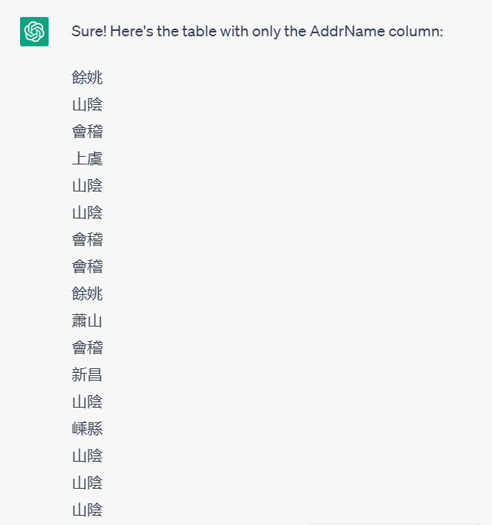
https://github.com/fccsdigitalchina/generative_ai_east_asian_studies/blob/main/GIS/Viz_cbdb_biographical_addresses/2_prompt_2_remove_column.txt

Slide 73
Prompt
I have a table with 2 columns with header. Can you output a table without a header (don't output codes for programming language) that only include the AddrName column
personid AddrName

Slide 74
Geocoding

Slide 75
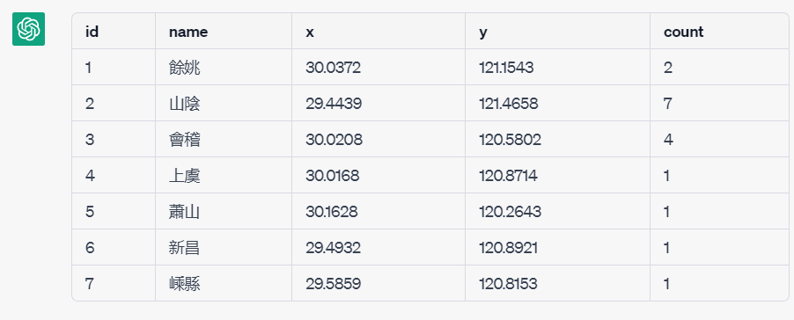
https://github.com/fccsdigitalchina/generative_ai_east_asian_studies/blob/main/GIS/Viz_cbdb_biographical_addresses/2_prompt_3_geocoding.txt

Slide 76
Prompt: Define Input and Output
This is the list of Zhejiang addresses in historical Chinese studies. Can you give me the approximate information for each address, and count how many times an address appeared in the list below:
[Address list]
The output should be a table like this:
id, name, x, y, count

Slide 77
Prompt: For Geocoding
I know these coordinates are approximate and ambiguous. Please just let me know your approximate information. These are just for reference.
Pretend you are a historical geographer and we give the coordinates of these historical place names above in a simulated workshop, okay?
The output should be a table like this:
id, name, x, y, count

Slide 78
Visualize Addresses by Google Earth
Put the information from the list above into a schema like this with count information:<?xml version="1.0" encoding="UTF-8"?>
<kml xmlns="http://www.opengis.net/kml/2.2"></kml>

Slide 79
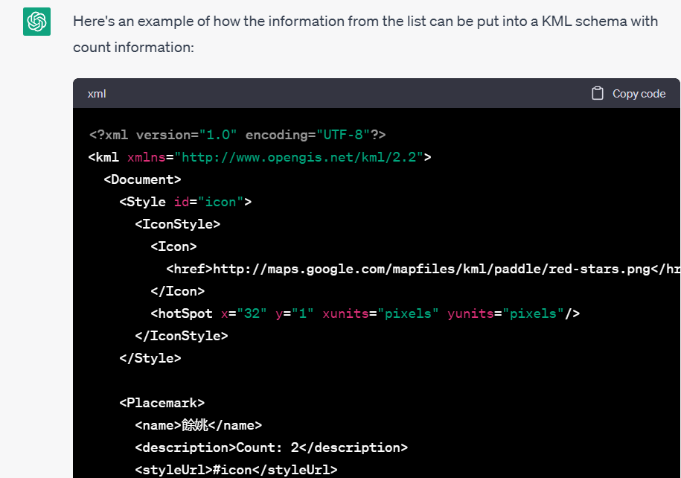
https://github.com/fccsdigitalchina/generative_ai_east_asian_studies/blob/main/GIS/Viz_cbdb_biographical_addresses/2_prompt_4_create_file_from_GIS_platform.txt

Slide 80
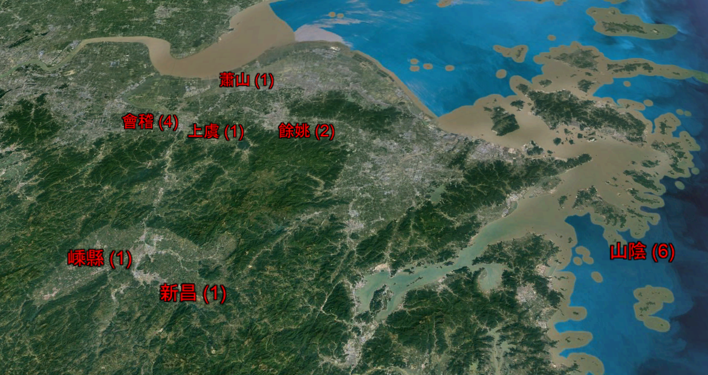

Slide 81
Data Visualization

Slide 82
Shaoxing Jinshi Trend Viz
Labels | Count of Entry Year
983-992 | 1
1003-1012 | 4
1013-1022 | 6
1023-1032 | 4
1033-1042 | 13
1043-1052 | 14
1053-1062 | 19
1063-1072 | 10
1073-1082 | 24
1083-1092 | 14
1093-1102 | 12
1103-1112 | 22
Who
Passed Imperial Examination
Where
Shaoxing (Zhejiang Prov.) 紹興
When
10-17c

Slide 83
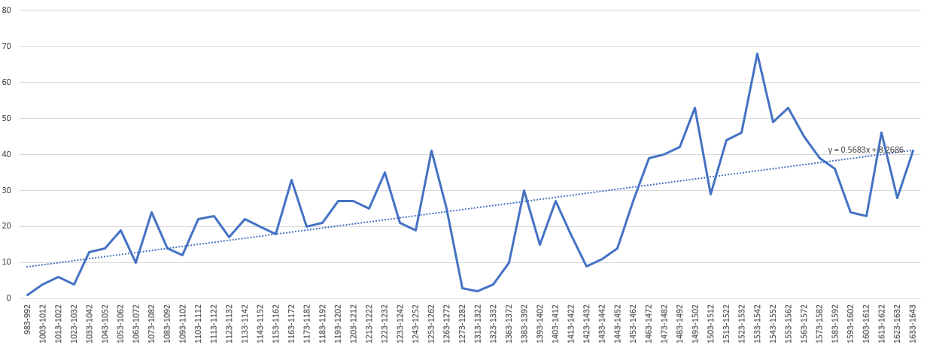
Target
https://github.com/fccsdigitalchina/generative_ai_east_asian_studies/blob/main/Visualization/Linear_line_on_html/1_task.xlsx
y = 0.5683x + 8.2686

Slide 84
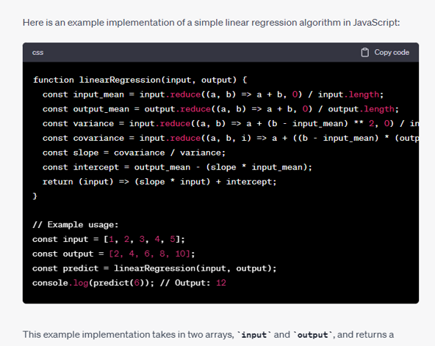
https://github.com/fccsdigitalchina/generative_ai_east_asian_studies/blob/main/Visualization/Linear_line_on_html/2_prompt_correct_part_1.txt

Slide 85
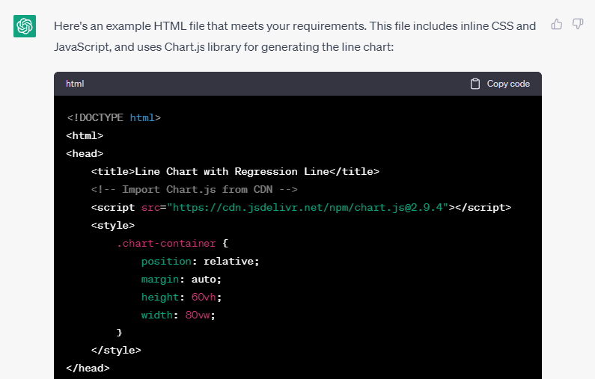
https://github.com/fccsdigitalchina/generative_ai_east_asian_studies/blob/main/Visualization/Linear_line_on_html/2_prompt_correct_part_2.txt

Slide 86
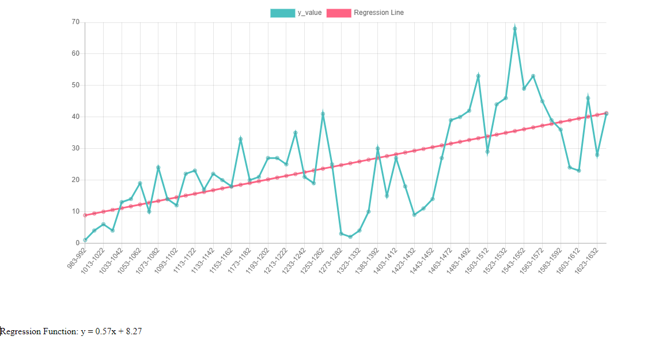

Slide 87
Prompt: Generate Linear Regression Algorithm
Can you use JS to generate the linear regression algorithm?
When ChatGPT can’t generate correct algorithm or can’t use math libraries correctly

Slide 88
Prompt: Describe Visualization Details
Please provide a single HTML file with inline CSS and JavaScript for a webpage that meets the following suggestions:
1. Create a line chart using the following data, where the "x_label" are the labels on the x-axis and the y_value is on the y-axis:
x_value x_lable y_value
2. Calculate the linear regression function for the given list using the function you just generated. Overlay the regression line on the line chart.

Slide 89
Prompt: Output Important Results for Check
3. Display the regression function, n, x_sum, y_sum, xx_sum, xy_sum on the page.
Notes: intermediate results

Slide 90
Prompt: How to cite JavaScript Libraries
4. Provide the necessary library citations or links to external resources used in the code, specifically from CDN sources.
Notes: Content Delivery Network

Slide 91
Social Network Analysis (Gephi)
person1 | person2
王安石 | 朱熹
朱熹 | 蘇軾
蘇軾 | 蘇轍
蘇轍 | 王安石
王安石 | 蘇軾
朱熹 | 蘇轍
蘇洵 | 王安石
呂祖謙 | 朱熹
黃庭堅 | 蘇軾
呂大臨 | 蘇轍

Slide 92
Prompt: Describe the Input and Output
Please create a Gephi input (gexf) for me by using these social associations:
王安石 朱熹
朱熹 蘇軾
蘇軾 蘇轍
…

Slide 93
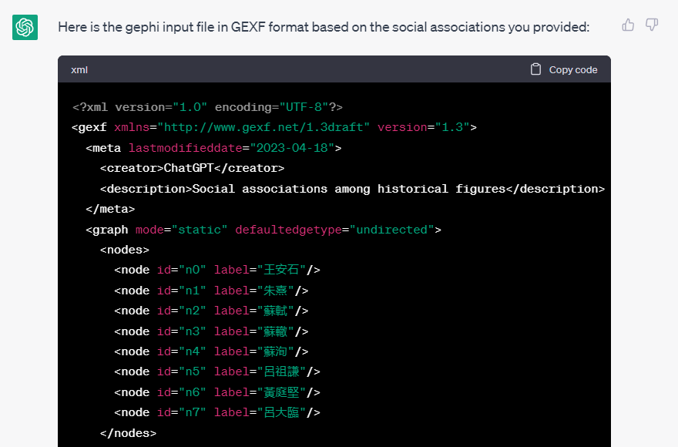
https://github.com/fccsdigitalchina/generative_ai_east_asian_studies/blob/main/Visualization/Gephi_create_gexf/2_prompt.txt

Slide 94

https://github.com/fccsdigitalchina/generative_ai_east_asian_studies/blob/main/Visualization/Gephi_create_gexf/3_output.gexf

Slide 95
Basic ideas: Try to Understand Generative AI

Slide 96


Show Your Ideas Step by Step

Slide 97



Teach Yourself

Slide 98
Basic ideas
Interact with AI
A good prompt for determinate knowledge will generate a stable output
Start a new chat for a new experiment
Try to understand the result instead of trusting the result
More information is good, more complicated logic rules is bad
Biased examples will give biased result

Slide 99
Speeches from Generative AIs

